Slide 1

Netflix Movie Analysis
Web scrapping project:
Brenda Parnin
DA-6223 Data Tools and Techniques

Slide 2

Research Question
Which movies currently on Netflix have the best IMDB score based on Director?

Slide 3
Web Scrapping
Website Used:
https://www.whats-on-netflix.com/library
What Data was Scrapped?
Directors (9) Analyzed:
Movie Title
Rating
IMDB Score (10 being the best)
Sofia Coppola | Noah Baumbach
Christopher Nolan | Michael Bay
David Fincher | McG
Steven Soderbergh | Aaron Sorkin
Ava DuVernay

Slide 4
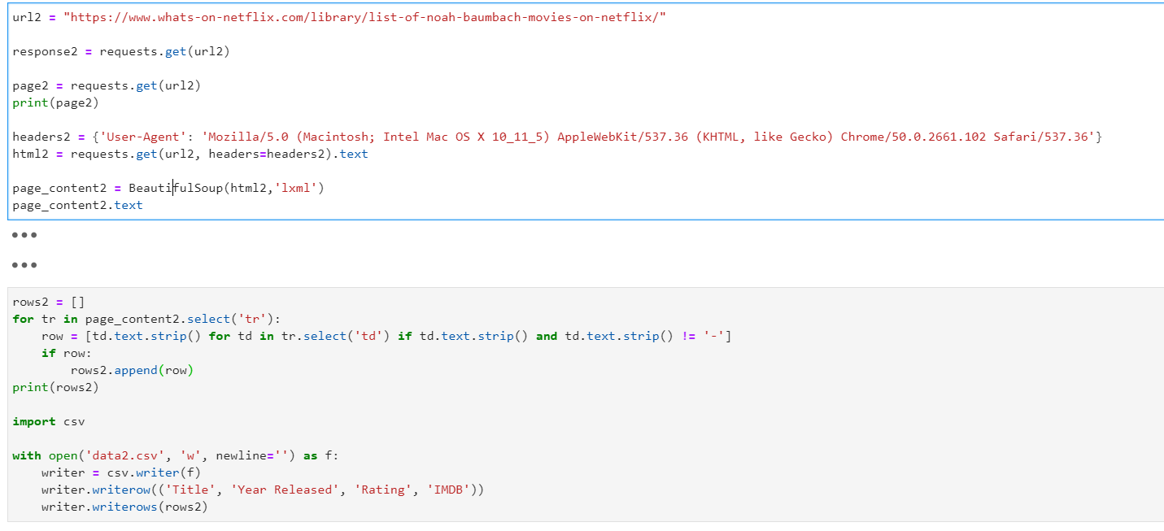
Web Scrapping – Python Code

Slide 5
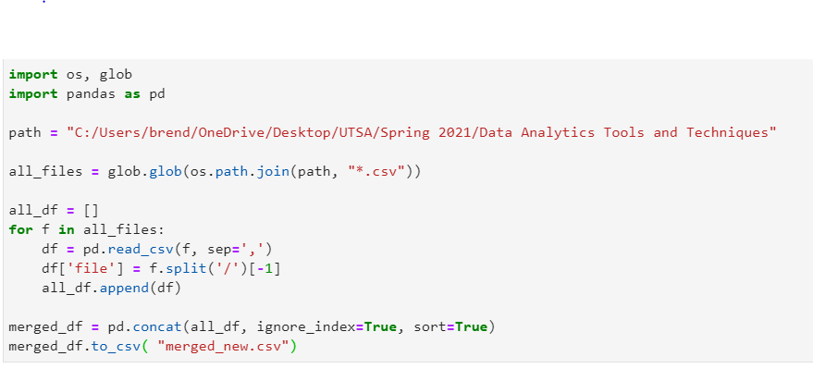
Web Scrapping – Python Code cont.

Slide 6
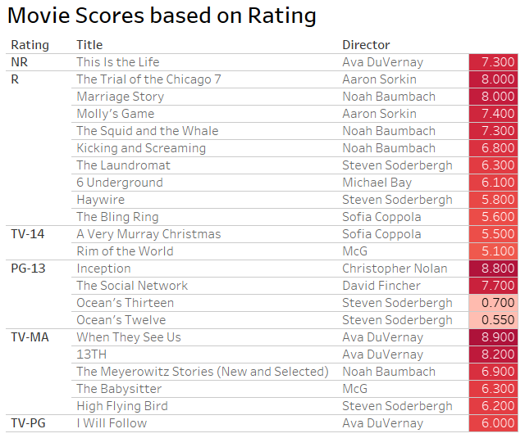
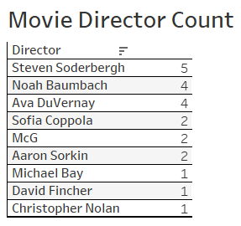
Visualizations

Slide 7
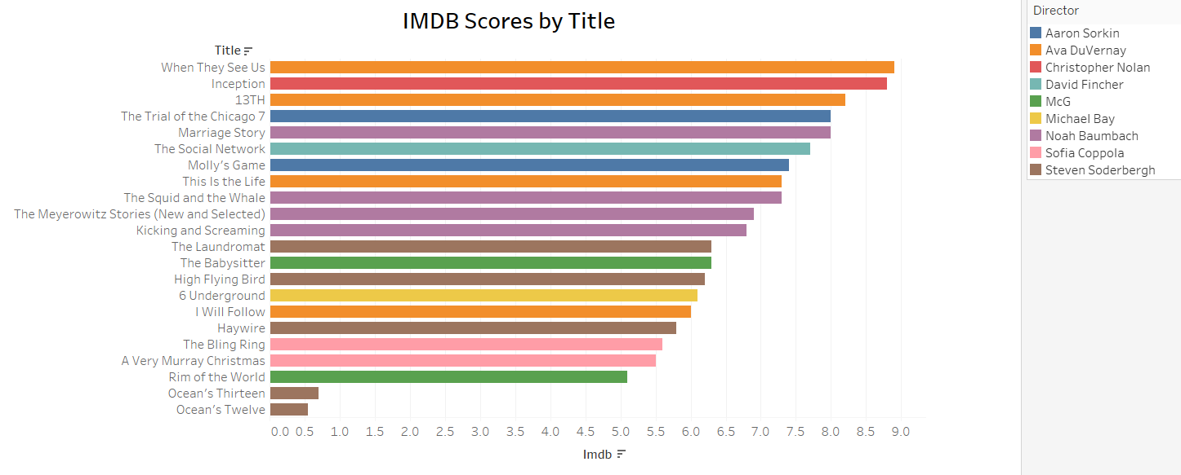
Visualizations cont.

Slide 8
Conclusion
Movie Scores based on Rating:
IMDB Scores based off Titles
Rating | Director | Title | Score
NR | Ava DuVernay | This Is the Life | 7.3
R | Aaron Sorkin | The Trial of the Chicago 7 | 8
TV-14 | Sofia Coppola | A Very Murray Christmas | 5.5
PG-13 | Christopher Nolan | Inception | 8.8
TV-MA | Ava DuVernay | When They See Us | 8.9
TV-PG | Ava DuVernay | I Will Follow | 6
Director | Title | Score
Ava DuVernay | When They See Us | 8.9
Christopher Nolan | Inception | 8.8
Ava DuVernay | 13TH | 8.2
Aaron Sorkin | The Trial of the Chicago 7 | 8
Noah Baumbach | Marriage Story | 8

